Slide 1

CO3: Simplify and break-down the techniques to solve some complex realistic problems into modular problems and their solutions.

Slide 2
Kruskal's Algorithm
MST-Kruskal (G,w)
A<-0
For each vertex v e V[G] Make-Set(v)
sort the edges(E) in increasing order by weight w
for each edge (u,v) e E
We construct a set of edges A satisfying the following invariant:
□ A is a subset of some
MST
We start with A empty
On each iteration, we add a suitable edge to A
In the case of Kruskal's algorithm, candidate edges are considered in order by increasing weight
if FindSet(u) *
FindSet(v)
A = A U { (u, v) }
UNION{u,v)

Slide 3

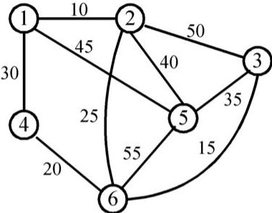

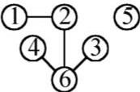
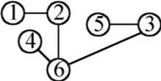
Kruskal's Algorithm
Edge
Cost
Spanning Forest
(Da)Q)@)(?)@
Q)-0) Q) @) (?) ®
(1,2)
(3,6)
10
15
Q)-0) @
0)
(4,6)
20
Q)-0)
3 (?)
(2,6)
25
(1,4)
(3,5)
30
(reject)
35

Slide 4
Application: The Minimal-Connector Problem
Given a connected graph in which each edge has a weight, find a spanning tree with minimum total cost.
  Kruskal's Algorithm: Build tree by repeatedly
adding min-weight edge that doesn't form a cycle
  Prim's Algorithm: Build tree by adding vertices, adjacent to tree so far, for which new edges have min weight and don't form cycle

Slide 5
Properties of Kruskal's and Prim's Algorithms
Both are greedy: They take the best
immediate choice without considering future ramifications
□Greedy algorithms don't always work best, but
these do.
Prim always maintains a connected graph, while Kruskal may not.

Slide 6
Measuring Efficiency of Graph Algorithms
Efficiency = Time complexity = (roughly) how many steps are needed as a function of N (number of vertices) and E (number of edges)
For any graph, 0 < E < N(N-1)/2 = O(N²)
For any connected graph, N-1 < E < N(N- 1)/2 , O(N) < E < O(N²)

Slide 7
Running time of Kruskal Algorithm
Kruskal:
  Sort E edges into increasing order: Best sorting algorithms take O(E log E) time
  Keep track of number of components, and never add an edge with both ends in the same component: O(N)
o Total is O(E log E), since O(N) < E
If E = O(N) then Kruskal is faster
If E = O(N²) then Prim is faster

Slide 8
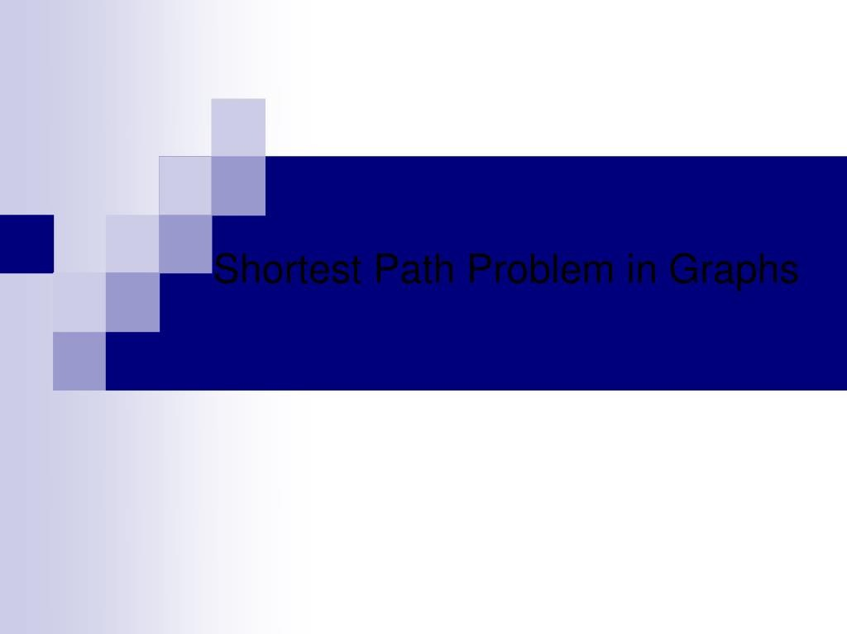

Slide 9
Problem
A motorist wishes to find the shortest possible route from Dhaka to Khulna.
Route map is given where distance between each pair of adjacent intersections is marked.
One possible way is to enumerate all the routes from Dhaka to Khulna, add up the distance on each route and select the shortest.
There are hundreds and thousands of possibilities, most of them are simply not worth considering.

Slide 10
Contd ...
A route from Dhaka to Rajshahi to Khulna is obviously a poor choice, as Rajshahi is hundreds of miles out of the way.
In this presentation, we show how to solve such problems efficiently.

Slide 11
Shortest path problem
Weare given a weighted, graph G=(V,E), with weight function w:E->R mapping edges to real-valued weights.
The weight of path P=<V₀,v₁, ... vk> is the sum of the weights of its constituent edges.

Slide 12
Variants
Assume that the graph is connected. The shortest path problem has several different forms:
Given two nodes A and B, find the shortest path in the weighted graph from A to B.
Given a node A, find the shortest path from A to every other node in the graph. (single­ source shortest path problem)
Find the shortest path between every pair of nodes in the graph. (all-pair shortest path problem)

Slide 13
Single-Source Shortest Path
Problem: given a weighted graph G, find the minimum-weight path from a given
source vertex s to another vertex v
□"Shortest-path" = minimum weight
□Weight of path is sum of edges

Slide 14
Dijkstra's Algorithm
Similar to breadth-first search
  Grow a tree gradually, advancing from vertices
taken from a queue
Also similar to Prim's algorithm for MST
  Use a priority queue keyed on d[v]

Slide 15
Dijkstra's Algorithm
The idea is to visit the nodes in order of their closeness to A; visit A first, then visit the closest node to A, then the next closest node to A, and so on.
The closest node to A, say X, must be adjacent to A and the next closest node, say Y, must be either adjacent to A or X. The third closest node to A must be either adjacent to A or X or Y, and so on. (Otherwise, this node is closer to A than the third closest node.)

Slide 16
Dijkstra's Algorithm
The next node to be visited must be adjacent to some visited node. We call the set of unvisited nodes that are adjacent to an already visited node the fringe.
The algorithm then selects the node from the fringe closest to A, say B, then visits B and updates the fringe to include the nodes that are adjacent to B. This step is repeated until all the nodes of the graph have been visited and the fringe is empty.

Slide 17
Dijkstra's Algorithm
Dijkstra(G)
for each v e V
d[v] = oo;
d[s] = 0; S = 0;
while (Q ¢ 0)
u = ExtractMin(Q);
Q = V;
S = S U {u};
for each v e u->Adj[]
Relaxation Step
Note: this ₋i£ (d [v]
> d [u]
+w (u, v))
is reallya
d [v]
= d [u] +w (u, v) ;
call to Q->DecreaseKey()

Slide 18
Dijkstra's Algorithm
How many times is ExtractMin() called?
How many times is DecreaseKey() called?
Q = V;
Dijkstra(G)
for each v e V
d[v] = oo,·
d[s] = 0; S = 0;
while (Q ¢ 0)
u = ExtractMin(Q);
S = S U {u};
for each v e u->Adj[]
if (d[v] > d[u]+w(u,v))
d[v] = d[u]+w(u,v);
What will be the total running time?

Slide 19
Dijkstra's Algorithm
How many times is ExtractMin() called?
Dijkstra(G)
for each v e V
d[v] = oo;
How many times is
Q = VDecreaseKey() called?
d[s] = 0; S = 0;
while (Q ¢ 0)
u = ExtractMin(Q);
S = S U {u};
for each v e u->Adj[]
if (d[v] > d[u]+w(u,v))
d[v] = d[u]+w(u,v);
A: O(E log V) using binary heap for Q

Slide 20

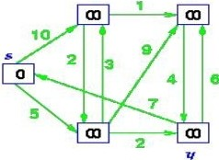
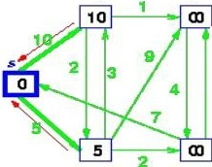
Step by Step operation of Dijkstra
algorithm
Stepl. Given initial graph G=(V, E). All nodes have infinite cost except the source node, s, which has O cost.
r,
V
X
Step 2. First we choose the node, which is closest to the source node, s. We initialize d[s] to 0. Add it to S. Relax all nodes adjacent to source, s. Update predecessor (see red arrow in diagram below) for all nodes updated.
r,
V
e
X
y

Slide 21
Step 3. Choose the closest node, x. Relax all nodes adjacent to node x. Update predecessors for nodes u, v and y (again notice red arrows in diagram below).
Step 4. Now, node y is the closest node, so add it to S. Relax node v and adjust its predecessor (red arrows remember!).
X
y

Slide 22

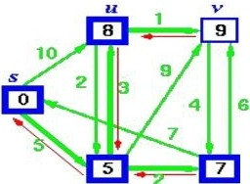
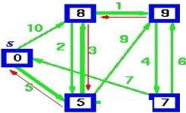
tep 5. Now we have node u that is closest. Choose this node and adjust its neighbor node v.
■
X
y
Step 6. Finally, add node v. The predecessor list now defines the shortest path from each node to the source node, s.
U V
.. 2
y
X

Slide 23
Analysis of Dijkstra Algorithm
Q as a linear array
EXTRACT_MIN takes O(V) time and there are IVI such operations. Therefore, a total time for EXTRACT_MIN in while-loop is O(V²).
Since the total number of edges in all the adjacency list is IEI. Therefore for-loop iterates IEI times with each iteration taking 0(1) time. Hence, the running time of the algorithm with array implementation is O(V² + E) = O(V²).
Q as a binary heap ( If G is sparse)
In this case, EXTRACT_MIN operations takes O(log V) time and there are IVI such operations. The binary heap can be build in O(V) time. Operation DECREASE (in the RELAX) takes O(log V) time and there are at most such operations.
Hence, the running time of the algorithm with binary heap provided given graph is sparse is O((V + E) log V). Note that this time
becomes O(E logV) if all vertices in the graph is reachable from the source vertices.

